Slide 1
MRI PLANNING
Setting up slices and coverage

Slide 2
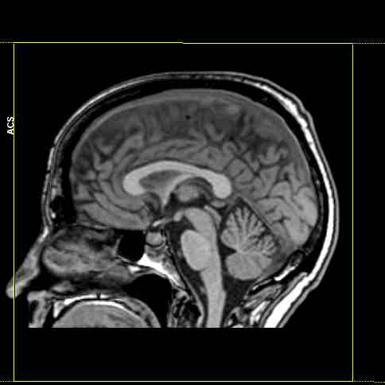
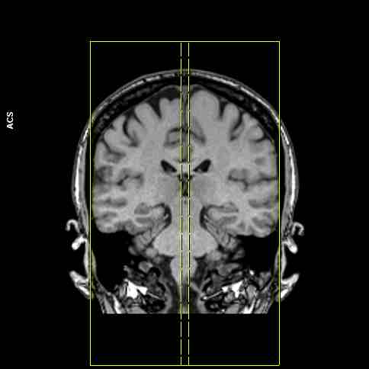
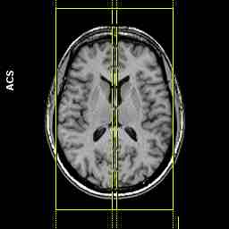
BRAIN-CENTER TO GLABELLA
Sagittal
Plane | Coverage
Sagittal | The FOV will cover from just above the head to the second vertebral body and entire brain from P to A
Coronal | align parallel with the longitudinal fissure to cover entire brain L to R
Axial | align parallel with the longitudinal fissure to cover entire brain L to R

Slide 3
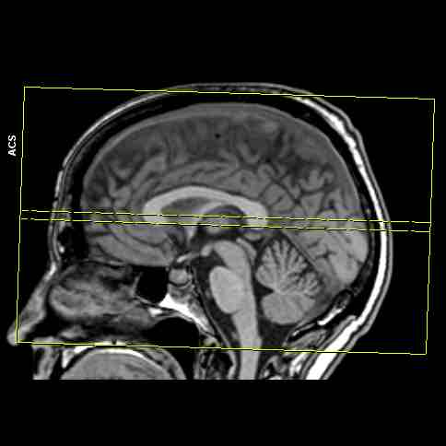
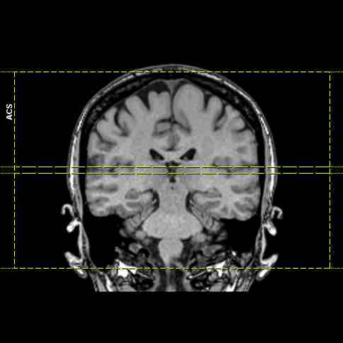
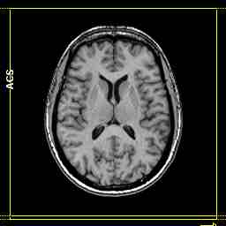
BRAIN
Axial
Plane | Coverage
Sagittal | align using the inferior aspect of the Genu and Splenium for reference and cover the brain from the top of the skull through the foramen magnum
Coronal | align perpendicular to longitudinal fissure
Axial | The FOV will cover the entire brain from L to R and P to A

Slide 4
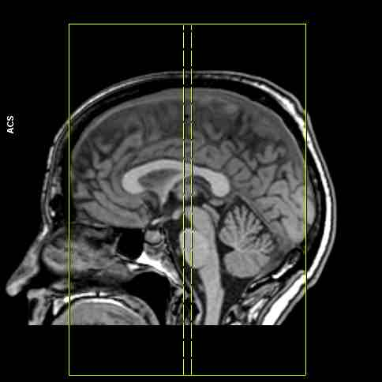
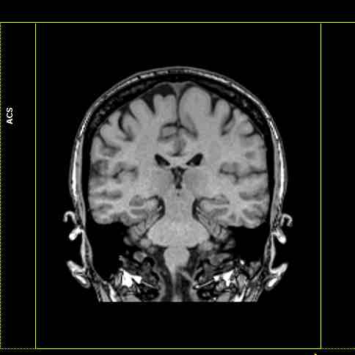
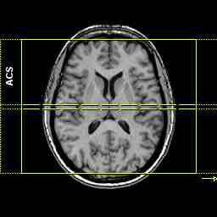
BRAIN
Coronal
Plane | Coverage
Sagittal | align parallel to the midbrain and cover entire brain P to A
Coronal | The FOV will cover from just above the head to the second vertebral body and entire brain from L to R
Axial | align perpendicular to longitudinal fissure

Slide 5
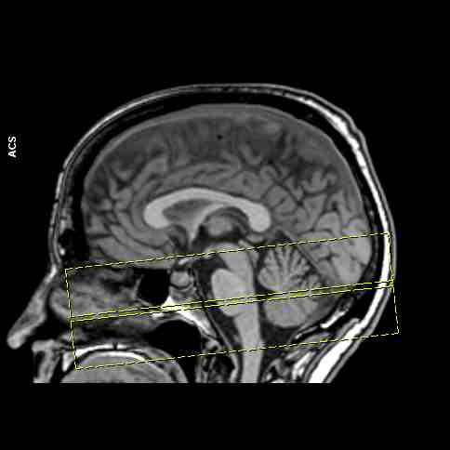
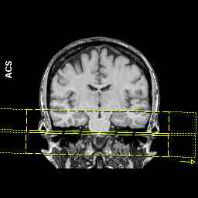
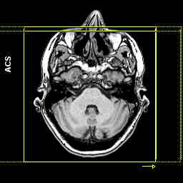
BRAIN & IAC’S
Axial
Plane | Coverage
Sagittal | align perpendicular to the midbrain and cover entire brain P to A
Coronal | align parallel with the IAC’s and cover from above the IAC’s to the foramen magnum
Axial | The FOV will cover the entire brain from L to R and P to A

Slide 6
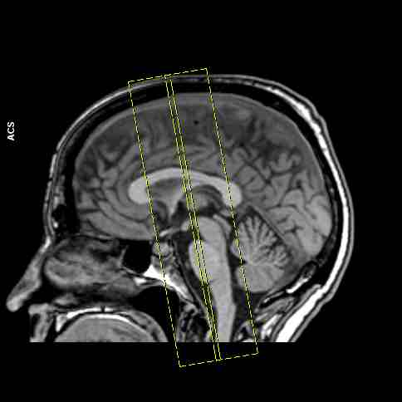
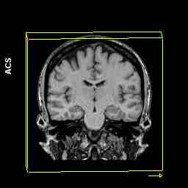
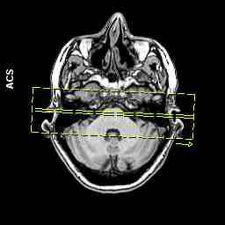
BRAIN & IAC’S
Coronal
Plane | Coverage
Sagittal | align parallel to the midbrain
Coronal | The FOV will cover the entire brain from L to R and S to I
Axial | align parallel with the IAC’s and cover from the sella to the fourth ventricle

Slide 7
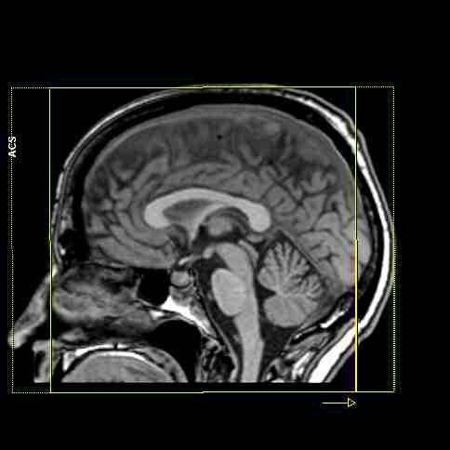
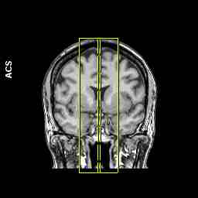
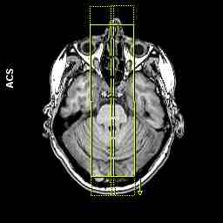
BRAIN & PITUITARY
Sagittal
Plane | Coverage
Sagittal | The FOV will cover entire pituitary gland
Coronal | align parallel with the longitudinal fissure and cover medial portion of temporal lobes
Axial | align parallel with the longitudinal fissure

Slide 8
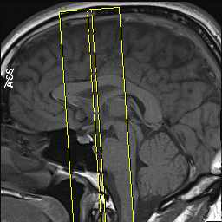
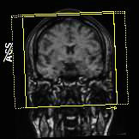
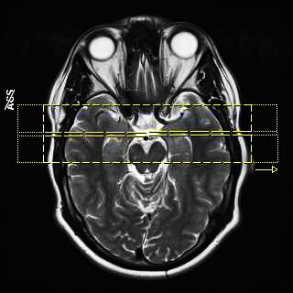
BRAIN & PITUITARY
Coronal
Plane | Coverage
Sagittal | align parallel to the midbrain and cover from the sphenoid sinus through the infundibulum
Coronal | The FOV will cover the entire pituitary gland
Axial | align perpendicular to longitudinal fissure

Slide 9
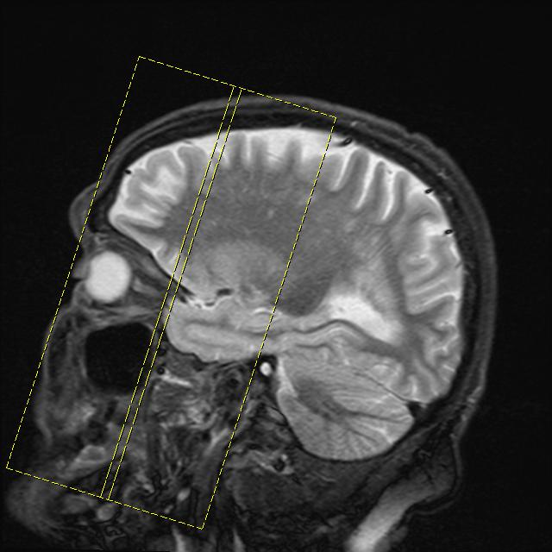
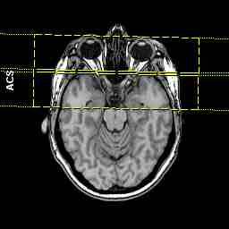
BRAIN & ORBITS
Coronal
Plane | Coverage
Sagittal | align perpendicular with optic nerves
Coronal | The FOV will cover bilateral optic nerves
Axial | align perpendicular with optic nerves and cover from the cornea through the optic chiasm

Slide 10
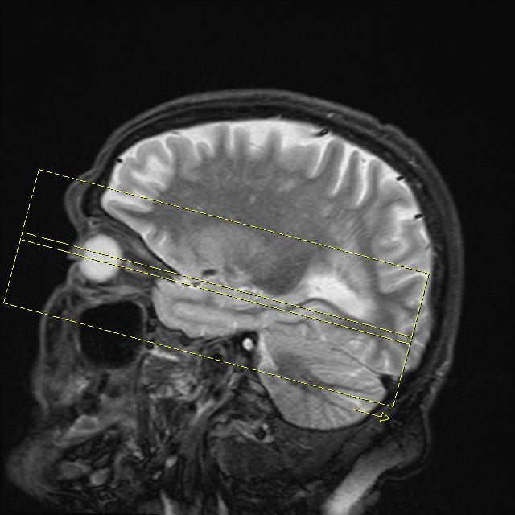
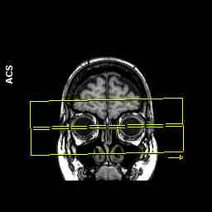
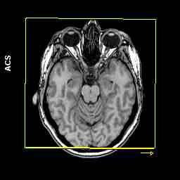
BRAIN & ORBITS
Axial
Plane | Coverage
Sagittal | align parallel with optic nerve and cover from the floor of the orbits to the roof
Coronal | align parallel to bilateral optic nerves
Axial | The FOV will cover from the cornea through the optic chiasm

Slide 11
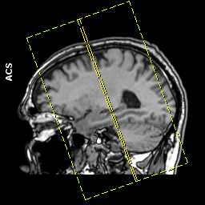
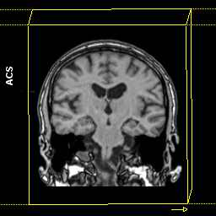
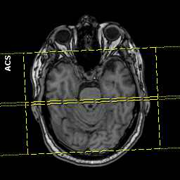
BRAIN FOR SIEZURE
Coronal
Plane | Coverage
Sagittal | align perpendicular to the temporal lobes covering through the brain
Coronal | The FOV will cover from just above the head to the second vertebral body and entire brain from L to R
Axial | align perpendicular to the temporal lobes covering from through the brain

Slide 12
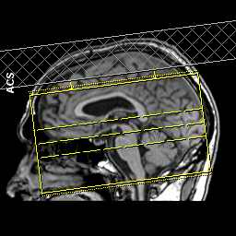
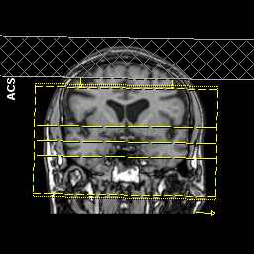
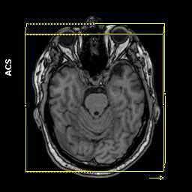
MRA HEAD-CENTER AT GLABELLA
Axial 3D TOF
Plane | Coverage
Sagittal | align perpendicular to brain stem and cover from foramen magnum to just above corpus callosum
Coronal | align perpendicular to the longitudinal fissure
Axial | The FOV will cover the entire brain from L to R and P to A

Slide 13
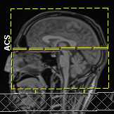
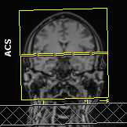
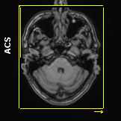
MRV HEAD
Axial 2D TOF
Plane | Coverage
Sagittal | align perpendicular to the head and cover from foramen magnum to just above scalp
Coronal | align perpendicular to the longitudinal fissure
Axial | The FOV will cover the entire head from L to R and P to A

Slide 14
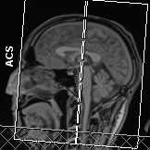
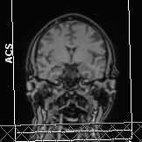
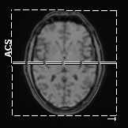
MRV HEAD
Coronal 2D TOF
Plane | Coverage
Sagittal | align parallel to the brain stem and cover entire head P to A
Coronal | The FOV will cover the entire head from L to R and P to A
Axial | align perpendicular to the longitudinal fissure

Slide 15
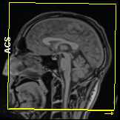
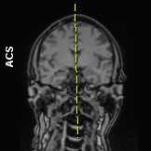
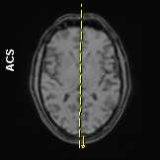
MRV HEAD
Sagittal PC
Plane | Coverage
Sagittal | The FOV will cover from just above the head to the second vertebral body and entire brain from P to A
Coronal | align parallel with the longitudinal fissure
Axial | align parallel with the longitudinal fissure

Slide 16
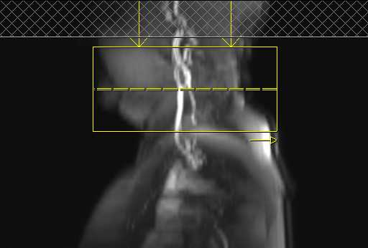
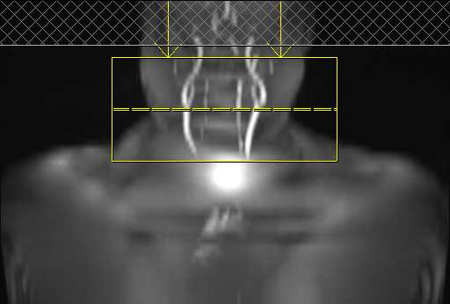
MRA NECK CENTER AT C4
Axial 2D TOF
Plane | Coverage
Sagittal | align perpendicular to the carotid arteries - center at bifurcation and cover 2 inches above and below carotid arteries
Coronal | align perpendicular to the carotid arteries
Axial | The FOV will cover the entire neck from L to R and P to A

Slide 17
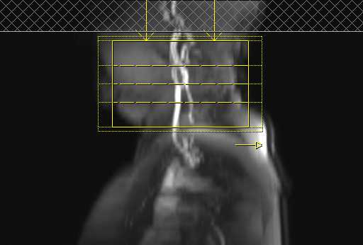
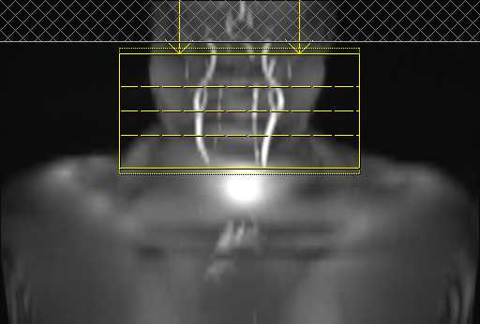
MRA NECK
Axial 3D TOF
Plane | Coverage
Sagittal | align perpendicular to the carotid arteries - center at bifurcation and cover 2 inches above and below carotid arteries
Coronal | align perpendicular to the carotid arteries
Axial | The FOV will cover the entire neck from L to R and P to A

Slide 18
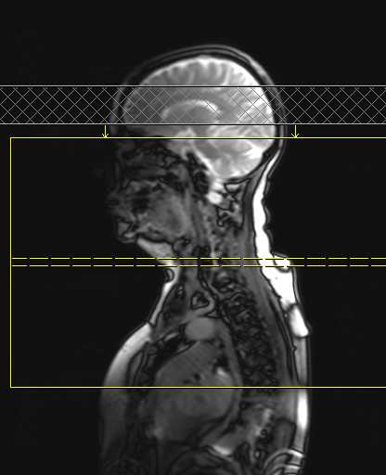
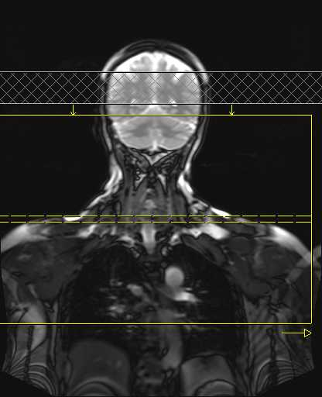
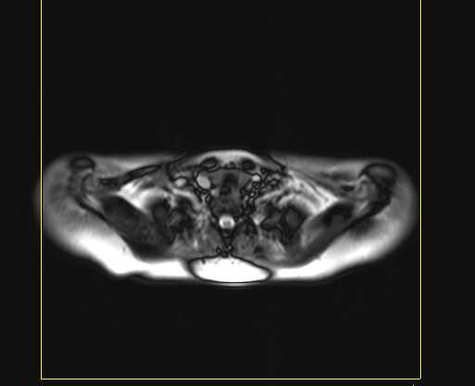
MRA NECK
Axial 2D TOF GLOBAL
Plane | Coverage
Sagittal | align parallel to the carotid arteries
Coronal | The FOV will cover from the arch of the heart to the Circle of Willis to include both right and left carotid and vertebral arteries
Axial | align parallel to the carotid arteries

Slide 19
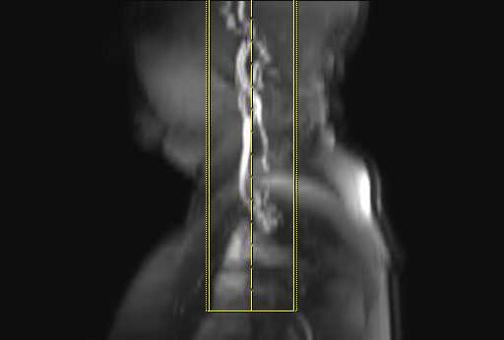
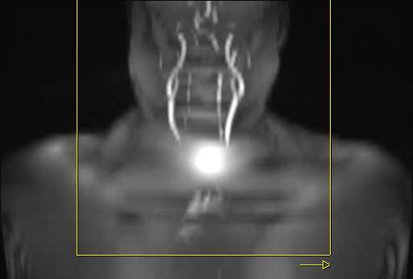
MRA NECK
Coronal 3D Contrast Enhanced
Plane | Coverage
Sagittal | align parallel to the carotid arteries
Coronal | The FOV will cover from the arch of the heart to the Circle of Willis to include both right and left carotid and vertebral arteries
Axial | align parallel to the carotid arteries

Slide 20



MRA RENAL ARTIERIES CENTER AT L2
Coronal 3D Contrast Enhanced
Plane | Coverage
Sagittal | align parallel to the abdominal aorta
Coronal | The FOV will cover from the diaphragm to include both right and left proximal iliac arteries
Axial | align orthogonally

Slide 21



MRA AORTA CENTER AT T7
Axial
Plane | Coverage
Sagittal | align orthogonally to cover above the aortic arch to just below diaphragm
Coronal | align orthogonally
Axial | The FOV will include Thoracic and Descending Aorta

Slide 22



MRA AORTA
Sagittal
Plane | Coverage
Sagittal | align with angle of the aortic arch
Coronal | The FOV will cover above the aortic arch to just below diaphragm
Axial | align orthogonally

Slide 23



SOFT TISSUE NECK CENTER AT C4
Sagittal
Plane | Coverage
Sagittal | The FOV will cover from sella to aortic arch and entire soft tissue neck P to A
Coronal | align parallel to cervical spine
Axial | align parallel to spinous process of the cervical spine

Slide 24



SOFT TISSUE NECK
Coronal
Plane | Coverage
Sagittal | align parallel to cervical spine
Coronal | The FOV will cover from sella to aortic arch and entire soft tissue neck L to R
Axial | align perpendicular to spinous process of the cervical spine

Slide 25



SOFT TISSUE NECK
Axial
Plane | Coverage
Sagittal | align perpendicular to the cervical spine
Coronal | align perpendicular to the cervical spine
Axial | The FOV will cover affected area

Slide 26



BRACHIAL PLEXUS CENTER AT C4
Sagittal
Plane | Coverage
Sagittal | The FOV will cover affected area or from C4 to T2
Coronal | align parallel to cervical spine and cover the middle of cervical spine to shoulder
Axial | align orthogonally

Slide 27



BRACHIAL PLEXUS
Coronal
Plane | Coverage
Sagittal | align parallel to cervical spine and cover the middle of cervical spine to shoulder
Coronal | The FOV will cover affected area or from C4 to T2
Axial | align orthogonally

Slide 28



BRACHIAL PLEXUS
Axial
Plane | Coverage
Sagittal | align perpendicular to the cervical spine
Coronal | align perpendicular to the cervical spine and cover the middle of cervical spine to shoulder
Axial | The FOV will cover affected area or from C4 to T2

Slide 29


CERVICAL SPINE CENTER AT C4
Sagittal
Plane | Coverage
Sagittal | The FOV will cover from the foramen magnum to second thoracic vertebrae
Coronal | align parallel to cervical spine and cover through the neural foramen of each disc space L to R
Axial | align orthogonally

Slide 30



CERVICAL SPINE
Coronal
Plane | Coverage
Sagittal | align parallel to cervical spine
Coronal | The FOV will cover from the foramen magnum to second thoracic vertebrae
Axial | align perpendicular to spinous process of the cervical spine

Slide 31


CERVICAL SPINE
Axial
Plane | Coverage
Sagittal | align perpendicular to the cervical spine
Coronal | align perpendicular to the cervical spine
Axial | The FOV will cover the cervical spine and nerve roots

Slide 32


THORACIC SPINE
Sagittal
Plane | Coverage
Sagittal | The FOV will cover from the body of C7 to the body of L1
Coronal | align parallel to thoracic spine and cover through the neural foramen of each disc space L to R
Axial | align orthogonally

Slide 33



THORACIC SPINE
Coronal
Plane | Coverage
Sagittal | align parallel to thoracic spine
Coronal | The FOV will cover from the body of C7 to the body of L1
Axial | align perpendicular to spinous process of the thoracic spine

Slide 34


THORACIC SPINE
Axial
Plane | Coverage
Sagittal | align perpendicular to the thoracic spine
Coronal | align perpendicular to the thoracic spine
Axial | The FOV will cover the thoracic spine and nerve roots

Slide 35


LUMBAR SPINE CENTER AT L3
Sagittal
Plane | Coverage
Sagittal | The FOV will cover from the body of T12 to the body S2
Coronal | align parallel to lumbar spine and cover through the neural foramen of each disc space L to R
Axial | align orthogonally

Slide 36



LUMBAR SPINE
Coronal
Plane | Coverage
Sagittal | align parallel to lumbar spine
Coronal | The FOV will cover from the body of C7 to the body of L1
Axial | align perpendicular to spinous process of the lumbar spine

Slide 37


LUMBAR SPINE
Axial
Plane | Coverage
Sagittal | align perpendicular to the lumbar spine
Coronal | align perpendicular to the lumbar spine
Axial | The FOV will cover the lumbar spine and nerve roots

Slide 38



SACRUM CENTER AS ASIS
Sagittal
Plane | Coverage
Sagittal | The FOV will cover from the body of L5 to coccyx
Coronal | align parallel to SI joints to cover through entire sacrum from L to R
Axial | align parallel to SI joints

Slide 39



SACRUM
Coronal
Plane | Coverage
Sagittal | align parallel to sacrum
Coronal | The FOV will cover from the body of L5 to coccyx
Axial | align perpendicular to the sacrum

Slide 40



SACRUM
Axial
Plane | Coverage
Sagittal | align perpendicular to the sacrum to cover from the body of L5 to coccyx
Coronal | align perpendicular to the sacrum
Axial | The FOV will cover the SI joints to cover through entire sacrum

Slide 41



PELVIS CENTER AT ASIS
Coronal
Plane | Coverage
Sagittal | align orthogonally
Coronal | The FOV will cover the entire pelvis
Axial | alignment parallel to a line across the roof each acetabulum

Slide 42



PELVIS
Axial
Plane | Coverage
Sagittal | align orthogonally
Coronal | alignment parallel to a line across the roof each acetabulum
Axial | The FOV will cover the entire pelvis

Slide 43



FEMALE PELVIS CENTER AT ASIS
Sagittal
Plane | Coverage
Sagittal | The FOV will cover the pelvis
Coronal | align parallel to the vaginanal cavity to cover from asis to asis
Axial | align orthogonally

Slide 44



FEMALE PELVIS
Coronal
Plane | Coverage
Sagittal | align perpendicular to the stripe of the uterine cavity
Coronal | The FOV will cover uterus and ovaries
Axial | align parallel to pubis symphisis

Slide 45



FEMALE PELVIS
Axial
Plane | Coverage
Sagittal | align parallel to the stripe of the uterine cavity
Coronal | align perpendicular to vaginanal cavity
Axial | The FOV will cover uterus and ovaries

Slide 46


URETHRA CENTER AT GREATER TROCHANTER
Sagittal
Plane | Coverage
Sagittal | The FOV will cover from above the bladder to below the labia
Coronal | align parallel to vagina
Axial | align orthogonally

Slide 47



URETHRA
Coronal
Plane | Coverage
Sagittal | align parallel to vagina
Coronal | The FOV will cover from above the bladder to below the labia
Axial | align orthogonally

Slide 48



URETHRA
Axial
Plane | Coverage
Sagittal | align perpendicular to the urethra
Coronal | align perpendicular to vagina
Axial | The FOV will cover urethra and vagina

Slide 49



PLACENTA CENTER AT ILIAC CREST
Sagittal
Plane | Coverage
Sagittal | The FOV will cover the area of interest
Coronal | align orthogonally to cover the area of interest
Axial | align orthogonally to cover the area of interest

Slide 50



PLACENTA
Coronal
Plane | Coverage
Sagittal | Angle with placenta
Coronal | The FOV will cover the area of interest
Axial | align orthogonally to cover the area of interest

Slide 51



PLACENTA
Axial
Plane | Coverage
Sagittal | align orthogonally to cover the area of interest
Coronal | align orthogonally to cover the area of interest
Axial | The FOV will cover the area of interest

Slide 52



APPENDIX CENTER AT ILIAC CREST
Coronal
Plane | Coverage
Sagittal | align orthogonally to cover the area of interest
Coronal | The FOV will cover the area of interest
Axial | align orthogonally to cover the area of interest

Slide 53


APPENDIX
Axial
Plane | Coverage
Sagittal | align orthogonally to cover the area of interest
Coronal | align orthogonally to cover the area of interest
Axial | The FOV will cover the area of interest

Slide 54



PROSTATE CENTER AT GREATER TROCHANTER
Sagittal
Plane | Coverage
Sagittal | The FOV will cover from the sacrum to pubic symphysis and seminal vesicles through bulb of the corpus spongiosum
Coronal | align perpendicular to pubis symphisis and cover L to R to include the seminal vesicles
Axial | align parallel to pubis symphisis

Slide 55



PROSTATE
Coronal
Plane | Coverage
Sagittal | align orthogonally
Coronal | The FOV will cover seminal vesicles through bulb of the corpus spongiosum
Axial | align parallel to pubis symphisis

Slide 56



PROSTATE
Axial
Plane | Coverage
Sagittal | align orthogonal slices to cover seminal vesicles through bulb of the corpus spongiosum
Coronal | align parallel to pubis symphisis
Axial | The FOV will cover from the sacrum to pubic symphysis and seminal vesicles through bulb of the corpus spongiosum

Slide 57



RECTUM CENTER AT ASIS
Sagittal
Plane | Coverage
Sagittal | The FOV will cover rectum through area of interest
Coronal | align parallel to bowel wall to cover through affected area
Axial | align orthogonally

Slide 58



RECTUM
Coronal
Plane | Coverage
Sagittal | align parallel to bowel wall to cover through affected area
Coronal | The FOV will cover rectum through area of interest
Axial | align parallel to pubis symphisis

Slide 59


RECTUM
Axial
Plane | Coverage
Sagittal | align perpendicular to bowel
Coronal | align perpendicular to bowel
Axial | The FOV will cover area of interest

Slide 60



FISTULA CENTER TO ASIS
Sagittal
Plane | Coverage
Sagittal | The FOV will cover the anterior abdominal wall through the body posteriorly
Coronal | align orthogonally centered to the pelvis
Axial | align orthogonally centered to the pelvis

Slide 61



FISTULA
Coronal
Plane | Coverage
Sagittal | align orthogonally centered to the area of interest
Coronal | The FOV will cover posterior to anterior through the area of interest
Axial | align orthogonally centered to the area of interest

Slide 62



FISTULA
Axial
Plane | Coverage
Sagittal | align orthogonally centered to the area of interest
Coronal | align orthogonally centered to the area of interest
Axial | The FOV will cover posterior to anterior through the area of interest

Slide 63



MRCP CENTER AT DIAPHRAGM
Coronal
Plane | Coverage
Sagittal | align parallel to CBD
Coronal | The FOV will cover from diaphragm through duodenum
Axial | align orthogonally and cover biliary tree and pancreas

Slide 64



MRCP
Axial
Plane | Coverage
Sagittal | align perpendicular to the body
Coronal | align perpendicular to the body cover from diaphragm through liver
Axial | The FOV will cover entire abdomen

Slide 65



LIVER CENTER AT DIAPHRAGM
Coronal
Plane | Coverage
Sagittal | align parallel to body
Coronal | The FOV will cover from diaphragm through through tail of liver
Axial | align perpendicular to the body

Slide 66



LIVER
Axial
Plane | Coverage
Sagittal | align perpendicular to the body
Coronal | align perpendicular to the body cover from diaphragm through tail of liver
Axial | The FOV will cover entire abdomen

Slide 67
PANCREAS CENTER AT DIAPHRAGM
Coronal
Plane | Coverage
Sagittal | align parallel to body
Coronal | The FOV will cover from diaphragm through through duodenum
Axial | align perpendicular to the body

Slide 68


PANCREAS
Axial
Plane | Coverage
Sagittal | align perpendicular to the body
Coronal | align perpendicular to the body cover from diaphragm through duodenum
Axial | The FOV will cover entire abdomen

Slide 69



KIDNEYS CENTER AT ILIAC CREST
Coronal
Plane | Coverage
Sagittal | align parallel to body
Coronal | The FOV will cover from adrenals through bilateral kidneys
Axial | align perpendicular to the body

Slide 70



KIDNEYS
Axial
Plane | Coverage
Sagittal | align perpendicular to the body
Coronal | align perpendicular to the body cover from adrenals through bilateral kidneys
Axial | The FOV will cover entire abdomen

Slide 71



ADRENALS CENTER AT ILIAC CREST
Coronal
Plane | Coverage
Sagittal | align parallel to body
Coronal | The FOV will cover from adrenals through bilateral kidneys
Axial | align perpendicular to the body

Slide 72



ADRENALS
Axial
Plane | Coverage
Sagittal | align perpendicular to the body
Coronal | align perpendicular to the body cover from adrenals through bilateral kidneys
Axial | The FOV will cover entire abdomen

Slide 73



SHOULDER CENTER AT GLENOHUMERAL JOINT
Axial
Plane | Coverage
Sagittal | align orthogonally
Coronal | align perpendicular to the glenohumeral joint to cover AC joint through glenohumeral joint
Axial | The FOV will cover deltoid to medial border of scapula

Slide 74



SHOULDER
Coronal
Plane | Coverage
Sagittal | align orthogonally
Coronal | The FOV will cover from AC joint through glenohumeral joint
Axial | align parallel to supraspinatous muscle or perpendicular to glenohumeral joint

Slide 75



SHOULDER
Sagittal
Plane | Coverage
Sagittal | The FOV will cover from AC joint through glenohumeral joint
Coronal | align parallel to glenohumeral joint from scapular notch through head of humerus
Axial | align perpendicuar to supraspinatous muscle or parallel to glenohumeral joint

Slide 76



ELBOW CENTER AT EPICONDYLES
Axial
Plane | Coverage
Sagittal | align perpendicular to ulna and radius
Coronal | align perpendicular to ulna and radius to cover from radioulnar joint through base of metacarpals
Axial | The FOV will cover entire wrist joint

Slide 77



ELBOW
Coronal
Plane | Coverage
Sagittal | align parallel to the shaft of the humerus
Coronal | The FOV will cover superior to the epicondyles through the radial tuberosity
Axial | align parallel to the epicondyles

Slide 78



ELBOW
Sagittal
Plane | Coverage
Sagittal | The FOV will cover superior to the epicondyles through the radial tuberosity
Coronal | align parallel to the shaft of the humerus
Axial | align perpendicular to the epicondyles

Slide 79



WRIST CENTER AT CARPALS
Axial
Plane | Coverage
Sagittal | align perpendicular to ulna and radius
Coronal | align perpendicular to ulna and radius to cover from radioulnar joint through base of metacarpals
Axial | The FOV will cover entire wrist joint

Slide 80



WRIST
Coronal
Plane | Coverage
Sagittal | align parallel to ulna and radius
Coronal | The FOV will cover from radioulnar joint through base of metacarpals
Axial | align orthogonally

Slide 81



WRIST
Sagittal
Plane | Coverage
Sagittal | The FOV will cover from radioulnar joint through base of metacarpals
Coronal | align parallel to ulna and radius
Axial | align perpendicular to ulna and radius

Slide 82



HAND CENTER TO PIP OF THIRD DIGIT
Coronal
Plane | Coverage
Sagittal | align parallel to metacarpals and phalanges
Coronal | The FOV will cover from radioulnar joint to finger tips
Axial | align orthogonally

Slide 83



HAND
Sagittal
Plane | Coverage
Sagittal | The FOV will cover from radioulnar joint to finger tips
Coronal | align parallel to metacarpals and phalanges
Axial | align orthogonally

Slide 84



HAND
Axial
Plane | Coverage
Sagittal | align parallel to metacarpals and phalanges
Coronal | align parallel to metacarpals and phalanges to cover from radioulnar joint to finger tips
Axial | The FOV will cover entire hand

Slide 85



HIPS CENTER AT GREATER TROCHANTER
Coronal
Plane | Coverage
Sagittal | align parallel to femoral shaft or orthoganal
Coronal | The FOV will cover from superior to the acetabulum through the lesser trochanter
Axial | align parallel to the neck of the femur and cover through the acetabulum or align parallel to the heads of both femurs

Slide 86



HIPS
Axial
Plane | Coverage
Sagittal | align perpendicular to femoral shaft or orthoganal
Coronal | align parallel to the neck of the femur and cover through the acetabulum or orthoganal
Axial | The FOV will cover entire will cover entire pelvis for bilateral exam and/or region of interest for unilateral exam

Slide 87


HIPS
Sagittal
Plane | Coverage
Sagittal | The FOV will cover from superior to the acetabulum through the lesser trochanter
Coronal | align perpendicular to the femoral neck covering from the greater trochanter through the acetabulum
Axial | align perpendicular to the femoral neck, parallel to acetabulum, or orthoganal

Slide 88



KNEE CENTER AT APEX
Axial
Plane | Coverage
Sagittal | align perpendicular to the femur and tibia and cover above patella through tibial tuberosity
Coronal | align parallel to the femoral condyles
Axial | The FOV will cover the entire knee

Slide 89



KNEE
Coronal
Plane | Coverage
Sagittal | align parallel to the femur and tibia
Coronal | The FOV will cover superior to patella through tibial tuberosity
Axial | align parallel to the medial aspect of the femoral condyle

Slide 90



KNEE
Sagittal
Plane | Coverage
Sagittal | The FOV will cover superior to patella through tibial tuberosity
Coronal | align parallel to the femoral condyles and cover through entire knee
Axial | align perpendicular to the femoral condyles

Slide 91



ANKLE CENTER AT MORTISE JOINT
Axial
Plane | Coverage
Sagittal | align perpendicular to tibia/fibula sagittally and cover talofibular joint through the calcaneus
Coronal | align perpendicular to tibia/fibula
Axial | The FOV will cover all the tarsals

Slide 92



ANKLE
Coronal
Plane | Coverage
Sagittal | align parallel to the tibia to cover from achilles to base of metatarsals
Coronal | The FOV will cover superior to cover talofibular joint through the calcaneus
Axial | align perpendicular to the talus

Slide 93



ANKLE
Sagittal
Plane | Coverage
Sagittal | The FOV will cover superior to cover talofibular joint through the calcaneus
Coronal | align perpendicular to tibiotalar joint
Axial | align parallel to the talus

Slide 94



FOOT CENTER MIDFOOT
Coronal or Short axis
Plane | Coverage
Sagittal | align parallel to metatarsals
Coronal | The FOV will cover distal tarsals through phalanges
Axial | align perpendicular to the talus

Slide 95




FOOT
Axial or Long axis
Plane | Coverage
Sagittal | align parallel to metatarsals covering entire foot left to right or orthoganal
Coronal | align parallel to metatarsals
Axial | The FOV will cover distal tarsals through phalanges

Slide 96



FOOT
Sagittal
Plane | Coverage
Sagittal | The FOV will cover distal tarsals through phalanges
Coronal | align perpendicular to coronal plane covering entire foot L to R
Axial | align parallel to the tarsals

Slide 97



LONG BONE CENTER MIDSHAFT
Coronal
Plane | Coverage
Sagittal | align parallel to shaft of bone
Coronal | The FOV will cover a joint through area of interest
Axial | align orthogonally

Slide 98



LONG BONE
Sagittal
Plane | Coverage
Sagittal | The FOV will cover a joint through area of interest
Coronal | align parallel to shaft of bone
Axial | align orthogonally

Slide 99



LONG BONE
Axial
Plane | Coverage
Sagittal | align perpendicular to shaft of bone
Coronal | align perpendicular to shaft of bone
Axial | The FOV will cover affected area

Slide 100



BREAST CENTER AT T7
Axial
Plane | Coverage
Sagittal | align orthogonally
Coronal | align orthogonally
Axial | The FOV will cover from axilla through entire breast

Slide 101



BREAST
Sagittal
Plane | Coverage
Sagittal | The FOV will cover from axilla through entire breast
Coronal | align orthogonally
Axial | align orthogonally

Slide 102



TMJ CENTER AT THE EAM
Sagittal
Plane | Coverage
Sagittal | The FOV will cover mandibular fossa L to R to include the ramus
Coronal | align parallel to ramus of mandible
Axial | align parallel to ramus of mandible

Slide 103



TMJ
Coronal
Plane | Coverage
Sagittal | align orthogonally
Coronal | The FOV will cover posterior to the mandibular fossa through coronoid process
Axial | align parallel bisecting the mandibular fossa bilaterally

